Slide 1
CS 331
Topic: Polymorphism and Virtual Functions Part 1
MD Romael Haque

Slide 2
Polymorphism and Virtual Member Functions
A piece of code is said to be polymorphic if executing the code with different types of data produces different behavior.
For example, a function would be called polymorphic if it executes differently when it is passed different types of parameters.

Slide 3
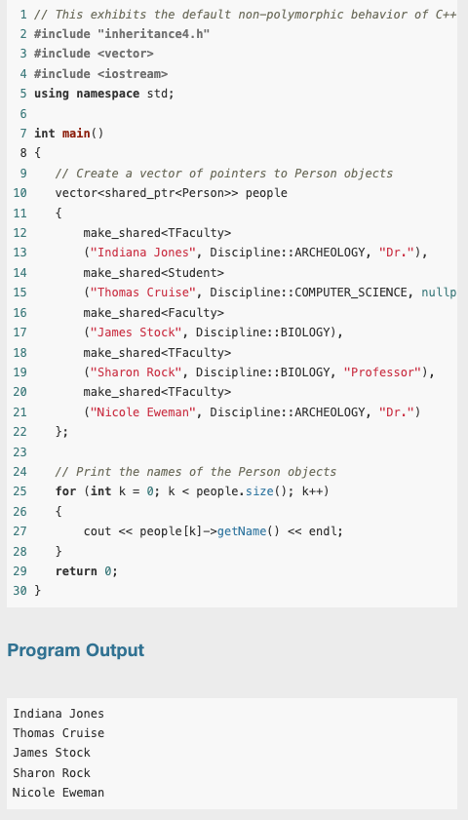
Polymorphism and Virtual Member Functions
To illustrate polymorphism, consider this program.
The program creates a vector of (pointers to) Person objects of type Student, Faculty, and TFaculty.
It then prints the names in all the objects using the same code.

Slide 4
Polymorphism and Virtual Member Functions
Notice that the program calls the Person version of the getName function for all objects in the array, even though the TFaculty objects have their own, more specialized version.
This code is obviously not polymorphic, for it executes the same member function for each object, regardless of its type.
In other words, it does not behave differently for different types of objects.

Slide 5
Polymorphism and Virtual Member Functions
To better understand what is happening, we need to take a closer look at each of the five calls used to retrieve the name to be printed: people[k]−>getName()
In each of these calls, a pointer people[k] to the base class Person is used to invoke the getName function in objects of different derived classes.
Some of these classes, like TFaculty, override getName to provide a more specialized version of that function.

Slide 6
Polymorphism and Virtual Member Functions
When people[k] is pointing to a TFaculty object, the compiler must choose between the getName defined in Person, the class of the pointer, and the getName defined in TFaculty, the class that the object actually belongs to.
The default C++ behavior is to use the class type of the pointer rather than that of the object to determine which version of an overridden function to call.

Slide 7
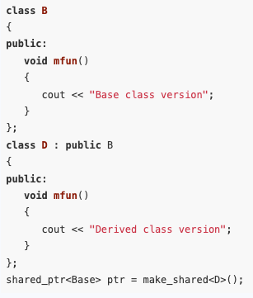
Polymorphism and Virtual Member Functions
The scenario of invoking a member function of a derived class object through a base class pointer is a common occurrence in object-oriented programming.
Let us say that we have a base class B with a member function mfun() and a base class pointer ptr that is pointing to an object of a derived class D.

Slide 8
Polymorphism and Virtual Member Functions
We want to tell the compiler that whenever we write
ptr−>mfun()
the compiler should select the more specialized version of mfun() in the derived class.
We can do this in C++ by declaring mfun() to be a virtual function in the base class.
Virtual functions are used in C++ to support polymorphic behavior.

Slide 9
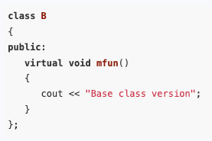
Polymorphism and Virtual Member Functions
Thus, to achieve polymorphic behavior for mfun() in the class B and all of its derived classes, we must modify the definition of B as follows:

Slide 10
Polymorphism and Virtual Member Functions
The virtual characteristic is inherited: That is, if a member function of a derived class overrides a virtual function in the base class, then that member function is automatically virtual itself.
Thus, the declaration of mfun as virtual in B makes mfun virtual in D and in all classes derived from D.
In our example, the virtual function has been defined inside the class declaration.
If a virtual member function is defined outside of the class declaration, the virtual key word goes on its declaration inside the class but not on the definition.

Slide 11
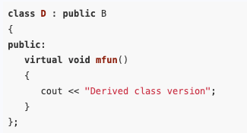
Polymorphism and Virtual Member Functions
Although it is not necessary, many programmers tag all virtual functions with the key word virtual to make it easer to identify them.
This is good practice, and accordingly, the definition of D should be written as follows:

Slide 12
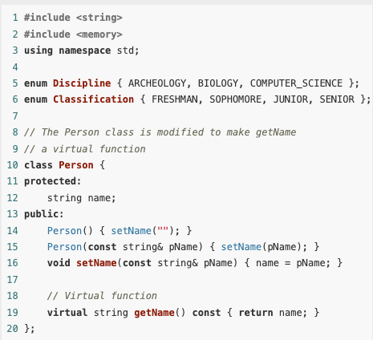
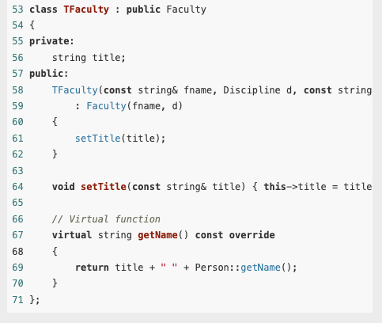
Example

Slide 13
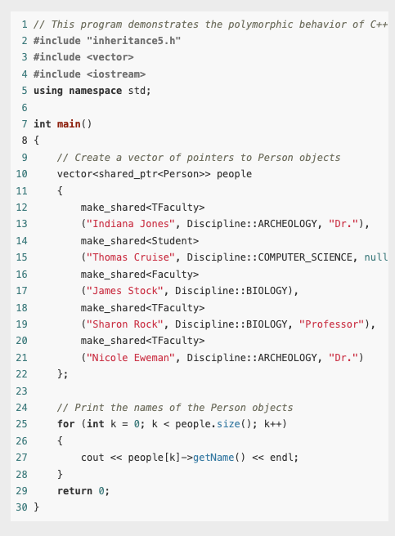

Example

Slide 14
Dynamic and Static Binding
The compiler is said to bind the name of a function when it selects the code that should be executed when the function name is invoked.
In other words, the compiler binds the name to a function definition when the function is called.

Slide 15
Dynamic and Static Binding
Static binding happens at compile time and binds the name to a fixed function definition, which is then executed each time the name is invoked.
In static binding, the compiler uses type information available at compile time.
If the code is operating on objects of different classes within an inheritance hierarchy, the only type information available to the compiler will be the base class pointer type used to access all the objects.
Consequently, static binding will always use the base class version of a member function.

Slide 16
Dynamic and Static Binding
In contrast, dynamic binding occurs at run time.
Dynamic binding works only if the compiler can determine at run time the exact class that a subclass object belongs to.
The compiler then uses this run-time type information to call the version of the function defined in that class.
To make dynamic binding possible, the compiler stores run-time type information in every object of a class with a virtual function.
Dynamic binding always uses the version of the member function in the actual class of the object, regardless of the class of the pointer used to access the object.

Slide 17
C++ 11’s override and final Key Words
C++ 11 introduces the override key word to help prevent subtle errors when overriding virtual functions.

Slide 18
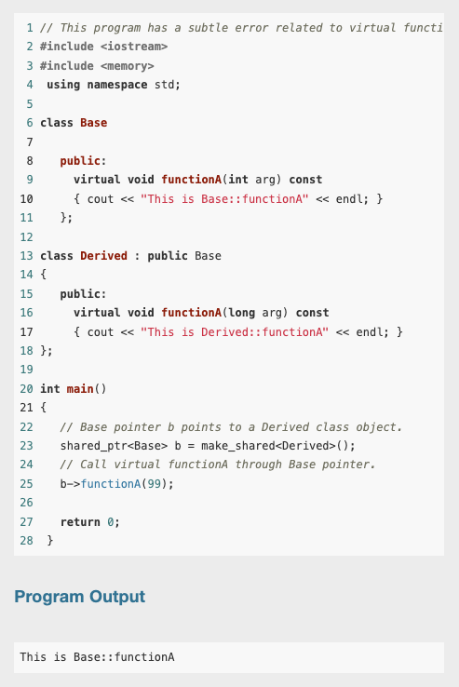
C++ 11’s override and final Key Words
There is a mistake in this program
In this program, a Base class pointer b is pointing to a Derived class object.
Because the functionA is virtual, we expect that the call to functionA through b will call the Derived class version.
This is not the case, however, as you can see from the program’s output.

Slide 19
C++ 11’s override and final Key Words
The reason is that the the two functions have different parameter types, so functionA in the Derived class does not override functionA in the Base class.
The function in the base class takes an int argument, but the one in the derived class takes a long argument.
So, functionA in the Derived class merely overloads functionA in the Base class.

Slide 20
C++ 11’s override and final Key Words
To make sure that a member function in a derived class overrides a virtual member function in a base class, you can place the override key word just after the derived class’s function prototype (or the function header, if the function is written inline).
The override key word tells the compiler that the function is supposed to override a function in the base class.
It will cause a compiler error if the function does not actually override any functions.

Slide 21
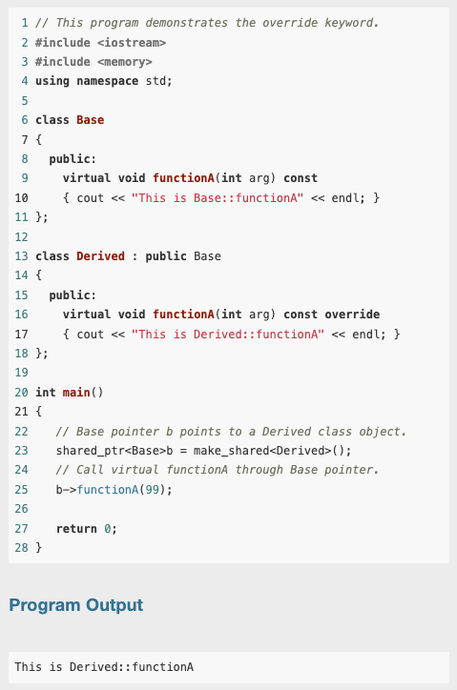
C++ 11’s override and final Key Words
This example demonstrates how previous example can be fixed so that the Derived class function does in fact override the Base class function.
Notice in line 16 that we have changed the parameter in the Derived class function to int, and we have added the override key word to the function header.

Slide 22
Preventing a Member Function from Being Overridden
In some derived classes, you might want to make sure that a virtual member function cannot be overridden any further down the class hierarchy.
When a member function is declared with the final key word, it cannot be overridden in a derived class.
The following member function prototype is an example that uses the final key word:
virtual void message() const final;
If a derived class attempts to override a final member function, the compiler generates an error.

Slide 23
Abstract Base Classes and Pure Virtual Functions
It is often convenient to have a base class for an inheritance hierarchy that defines a member function that must be implemented in every derived class but cannot be implemented by the base class itself because the details needed for a reasonable implementation can only be found in the derived classes.
If this is the case, the C++ language permits the programmer to declare the function a pure virtual function, that is, a member function for which the class provides no implementation.

Slide 24
Abstract Base Classes and Pure Virtual Functions
The C++ way of declaring a pure virtual function is to put the expression = 0 in the class declaration where the body of the function would otherwise have gone.
For example, if a member function void draw() is being declared pure virtual, then its declaration in its class looks like
void draw() = 0

Slide 25
Abstract Base Classes and Pure Virtual Functions
A pure virtual function is sometimes called an abstract function, and a class with at least one pure virtual function is called an abstract class.
The C++ compiler will not allow you to instantiate an abstract class.
Abstract classes can only be subclassed: That is, you can only use them as base classes from which to derive other classes.

Slide 26
Abstract Base Classes and Pure Virtual Functions
A class derived from an abstract class inherits all functions in the base class and will itself be an abstract class unless it overrides all the abstract functions it inherits.
The usefulness of abstract classes lies in the fact that they define an interface that will then have to be supported by objects of all classes derived from it.

Slide 27
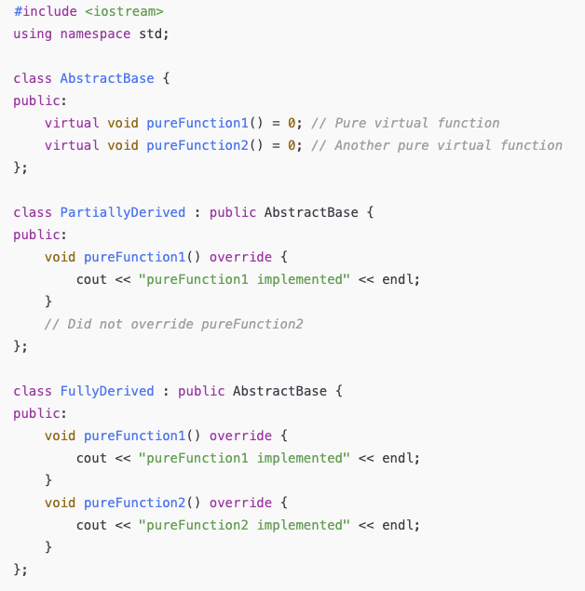
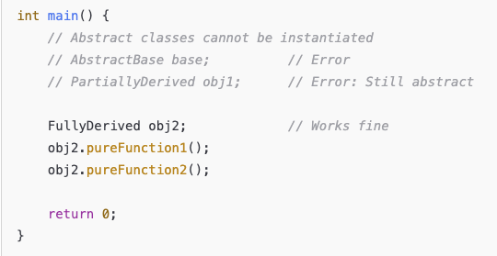
Example

Slide 28
Abstract Base Classes and Pure Virtual Functions
You can think of an abstract class as a class that has no instances other than those that belong to some subclass.
There are many examples of abstract classes in real life. For example, in the animal kingdom, the class “Animal” of all animals is an abstract class.
There are no instances of animals that do not actually belong to some subclass. There are animals that are dogs, or chickens, or foxes, but there no animals that are just animals.

Slide 29
Abstract Base Classes and Pure Virtual Functions
Consider a graphics system that consists of a collection of shapes that must be drawn at certain locations on the screen.
Each shape object would have some member variables to keep track of its position and a member function for drawing the shape at the right position.
The different shapes supported by the system might include rectangles, hexagons, and others.
Because a rectangle is a shape and a hexagon is a shape, it makes sense to have a Shape class and have both Rectangle and Hexagon be classes derived from Shape.

Slide 30
Abstract Base Classes and Pure Virtual Functions
The Shape class will have a member function setPosition for setting the position of the shape, as well as a member function draw for drawing the shape.
However, because Shape is an abstract class (there is no shape that is just a “shape”; it must be a rectangle, a hexagon, a triangle, or other) the logic for drawing a particular shape must be delegated to an appropriate subclass.
Thus, the draw() function cannot have an implementation in the Shape class and must be made a pure virtual function.

Slide 31
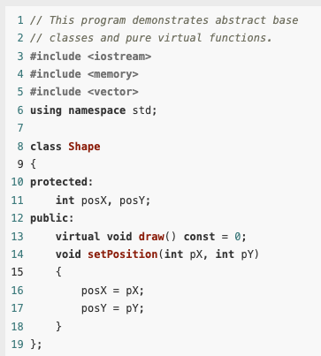
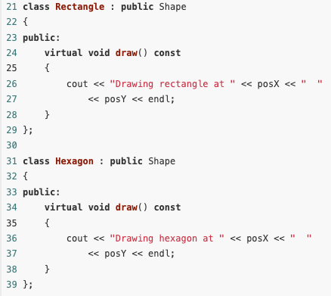
Example

Slide 32
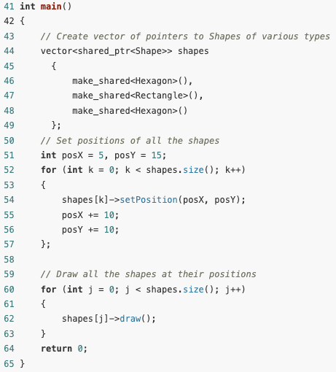
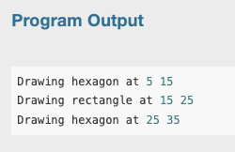
Example

Slide 33
Example
This example affords another demonstration of dynamic binding and polymorphism.
Consider in particular the statement which is executed a number of different times in the loop shapes[j]−>draw();
The first time the statement is executed, it invokes the draw function on a hexagon object, while the second time, it invokes the draw function on a rectangle object.
Because the two draw functions are in different classes, they produce different behavior.

Slide 34
Abstract Base Classes and Pure Virtual Functions
Remember the following points about abstract base classes and pure virtual functions:
When a class contains a pure virtual function, it is an abstract base class.
Abstract base classes cannot be instantiated.
Pure virtual functions are declared with the = 0 notation and have no body or definition.
Pure virtual functions must be overridden in derived classes that need to be instantiated.

Slide 35
Composition versus Inheritance
Inheritance should model an “is −a” relation, rather than a “has −a” relation, between the derived and base classes.
Class inheritance in an object-oriented language should be used to model the fact that the type of the derived class is a special case of the type of the base class.

Slide 36
Composition versus Inheritance
Actually, a class can be considered to be the set of all objects that can be created from it.
Because the derived class is a special case of the base class, the set of objects that correspond to the derived class will be a subset of the set of objects that correspond to the base class.
Thus, every object of the derived class is also an object of the base class. In other words, each derived class object is a base class object.

Slide 37
Composition versus Inheritance
Class composition occurs whenever a class contains an object of another class as one of its member variables.
We know that composition models a has-a relation between classes.
Because a derived class inherits all the members of its base class, a derived class effectively contains an object of its base class.
As a result, it is possible to use inheritance where a correct design would call for composition.

Slide 38

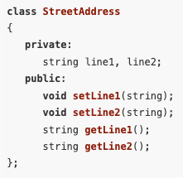
Composition versus Inheritance
As an example, consider a program that needs to represent data for a person, say the person’s name and street address.
The street address might consist of two lines:
Now suppose we had a class for representing a street address:

Slide 39
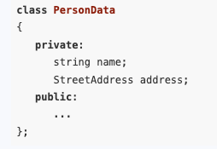
Composition versus Inheritance
Because a person’s data has a name and a street address, the proper formulation of a class to represent a person’s data would use composition in the following way:

Slide 40
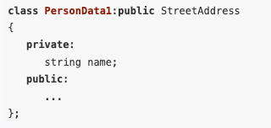
Composition versus Inheritance
It is possible to define this class using inheritance instead of composition.
For example, we could define a class PersonData1 as follows:

Slide 41
Composition versus Inheritance
While this new definition would compile correctly, it is conceptually the wrong thing to do because it regards a person’s data as a special kind of StreetAddress, which it is not.
This type of conceptual error in design can result in a program that is confusing to understand and difficult to maintain.
It is a good design practice to prefer composition to inheritance whenever possible.
One reason is that inheritance breaks the encapsulation of the base class by exposing the base class’s protected members to the methods of the derived class.

Slide 42
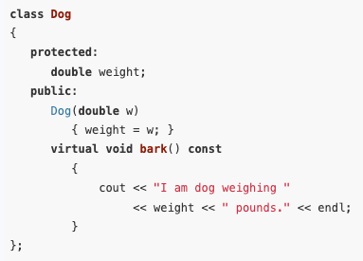
Composition versus Inheritance
Let us next consider an example where it makes sense to use inheritance rather than composition.
Suppose that we have a class Dog that represents the set of all dogs.
Assuming that each Dog object has a member variable weight of type double and a member function void bark()
The class also has a constructor to allow Dog objects to be initialized.
Note that we have declared the bark() member function as virtual to allow it to be overridden in a derived class.

Slide 43
Composition versus Inheritance
Suppose that we need to have a class that represents the set of all sheep dogs.
Since every sheep dog is also a dog, it makes sense to derive the new SheepDog class from the Dog class.
That way, a SheepDog object will inherit every member of the Dog class.

Slide 44
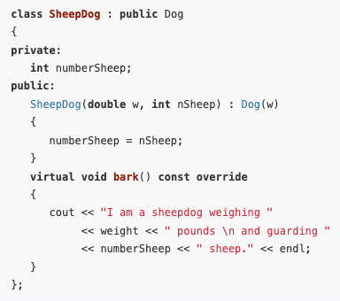
Composition versus Inheritance
In addition to having every characteristic that every dog has, a sheep dog can be expected to have other characteristics peculiar to sheep dogs.
For example, an integer member numberSheep that indicates the maximum number of sheep the dog is trained to herd.
In addition, a sheep dog might have a way of barking different from that of a generic dog, perhaps one adapted to the tending of sheep.
This is accounted for by overriding the bark() member function of the Dog class.

Slide 45
Composition versus Inheritance
To demonstrate this class, we will set up a vector of dogs with some of the dogs in the vector being sheep dogs.
To get around the fact that a vector cannot hold two different types, we will use a vector of pointers to Dog.
We know that a pointer to a base class (in this case, Dog) can point to any derived class object (in this case, SheepDog).
We can therefore create a vector of pointers to Dog and have some of those pointers point to Dog objects while others point to SheepDog objects.

Slide 46
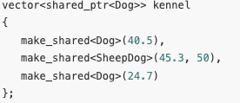
Composition versus Inheritance
We can therefore create a vector of pointers to Dog and have some of those pointers point to Dog objects while others point to SheepDog objects.

Slide 47
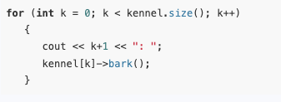
Composition versus Inheritance
Finally, we can use a loop to call the bark()member function of each Dog object in the array.
Because of polymorphism, and because the bark() function was declared virtual, the same line of code inside the loop will call the original bark() function for a regular dog but will call the specialized bark() function for a sheep dog.

Slide 48
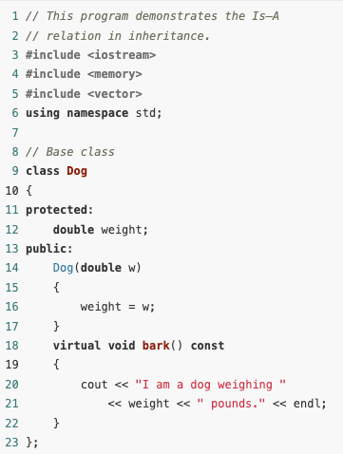
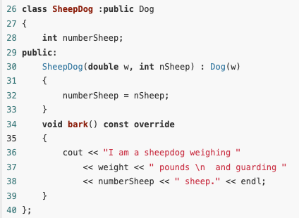
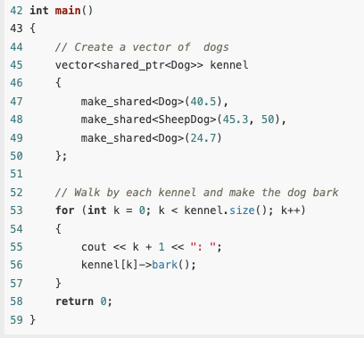
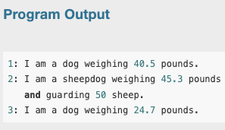
Complete Example

Slide 49
Composition versus Inheritance
Inheritance is a better choice than composition in this example, since to use composition would be tantamount to saying that a sheep dog has a dog, instead of saying that a sheep dog is a dog.
How can you know when to use inheritance and when to use composition?

Slide 50
Composition versus Inheritance
Suppose that you have an existing class C1 and you need to write a definition for another class C2 that will need the services of an associated C1 object.
Should you derive C2 from C1, or should you give C2 a member variable of type C1?
In general, you should prefer composition to inheritance.

Slide 51
Composition versus Inheritance
To help determine if inheritance may be appropriate, you might ask the following questions:
Is it natural to think of a C2 object as a special type of C1 object? If so, then you should use inheritance.
Will objects of class C2 need to be used in places where objects of class C1 are used? For example, will they need to be passed to functions that take reference parameters of type C1, or pointers to C1? If so, then you should make C2 a derived class of C1.

